Slide 1


FIR_MAC design Project
EE-417 PLD
Name: Lamin Jammeh

Slide 2

Digital Signal Processing using FIR_MAC filter
Formal Analysis of the design was done in MATLAB
The design Specifications are defined
Filter order (n)
Max Frequency (fmax)
Cut-off Frequency (fc)
Filter Type (low, high, bandpass, etc.)
Design Specs help determine filter coefficient using MATLAB functions like,
Fir1: takes (filter order, fc:fmax, filter Type)
Filter: takes (coeff, 1, sample signal)

Slide 3
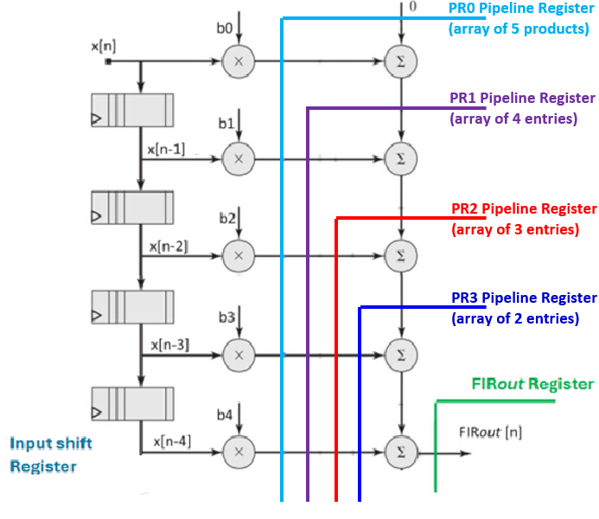
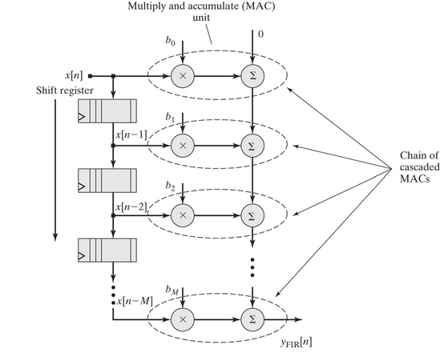
Design Process Flow

Slide 4
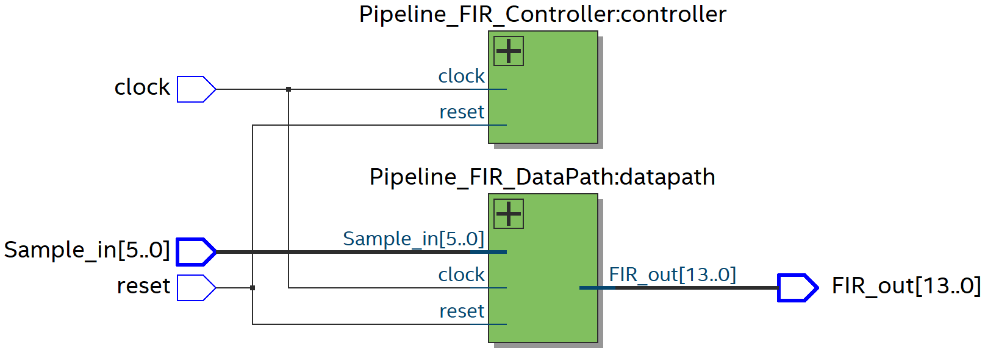
Signal Flow
FIR_MAC filter has 2 submodules
Controller
Datapath
The controller controls the reset signal
The Datapath waits for the reset signal and the posedge of the clock signal
At reset high all register are cleared
At reset low and posedge of clock the filter accepts input signals

Slide 5
Hardware Limitations
Timing constraints
Improve by adjusting the clock period
Available Registers in the FPGA
Improve by designing ASIC chip for the application (hard to reuse on other applications)
Use register rich FPGA
Powerline Interference (PLI) of the hardware
Use materials that allow for fast switch without altering the signal integrity example Silicon Carbide (SiC) base chips

